Slide 1






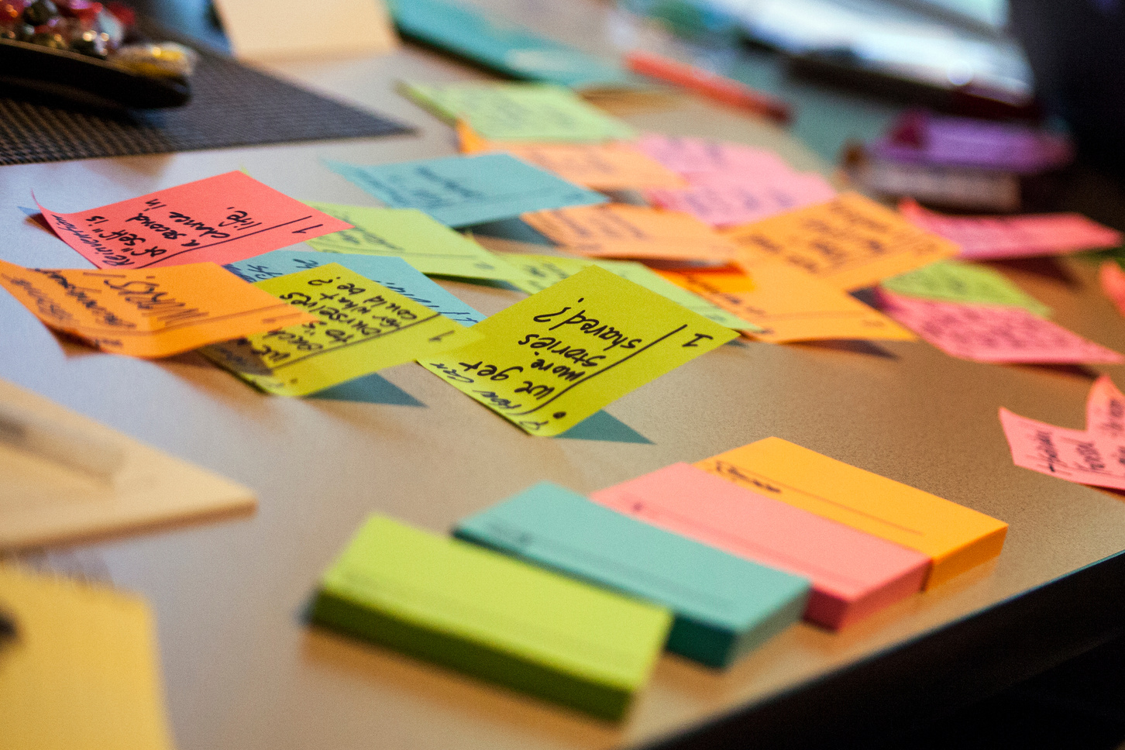


Impact of Artificial Intelligence on Usage Patterns and Digital
Trends
PRESENTATION 2026
Student Name
Student Email
Guide
Priyanshi Patel
Aayushi Soni
Vruti Patel
priyanshipatel170206@gmail.com
aayushisoni8910@gmail.com
vrutipatel509@gmail.com
Jyoti Prajapati

Slide 2

OUTLINE
Abstract of the Project
Problem Statement
Proposed Solution
System Architecture
Live Demo of the Project
Embedded Video of Project
Conclusion
Future Scope

Slide 3
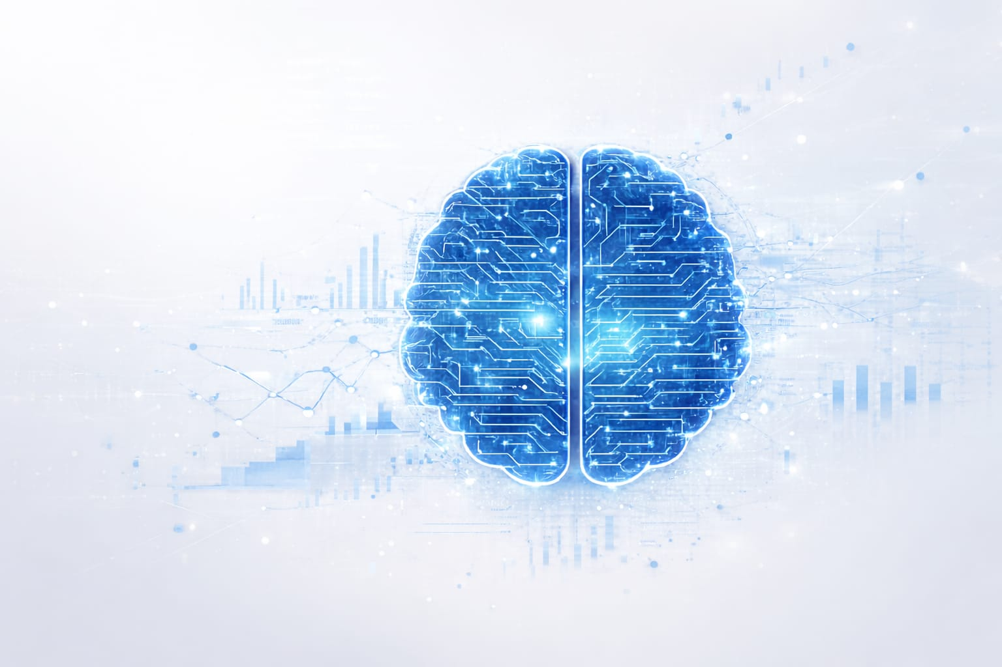
Abstract
This project studies Artificial Intelligence on AI Usage Patterns and Digital Trends during the period 2023 to 2025.
The objective is to understand how AI has influenced user behaviour, internet usage, digital consumption, risk perception, and cost trends.
The analysis is based on data collected from 300 respondents across multiple countries and age groups.
Using Power BI, the data was visualized through interactive dashboards to identify patterns, trends, and key insights. The findings reveal a steady increase in AI adoption, significant changes in usage patterns, and growing awareness of AI-related risks.
This project highlights the evolving role of Artificial Intelligence in shaping modern digital lifestyles.

Slide 4
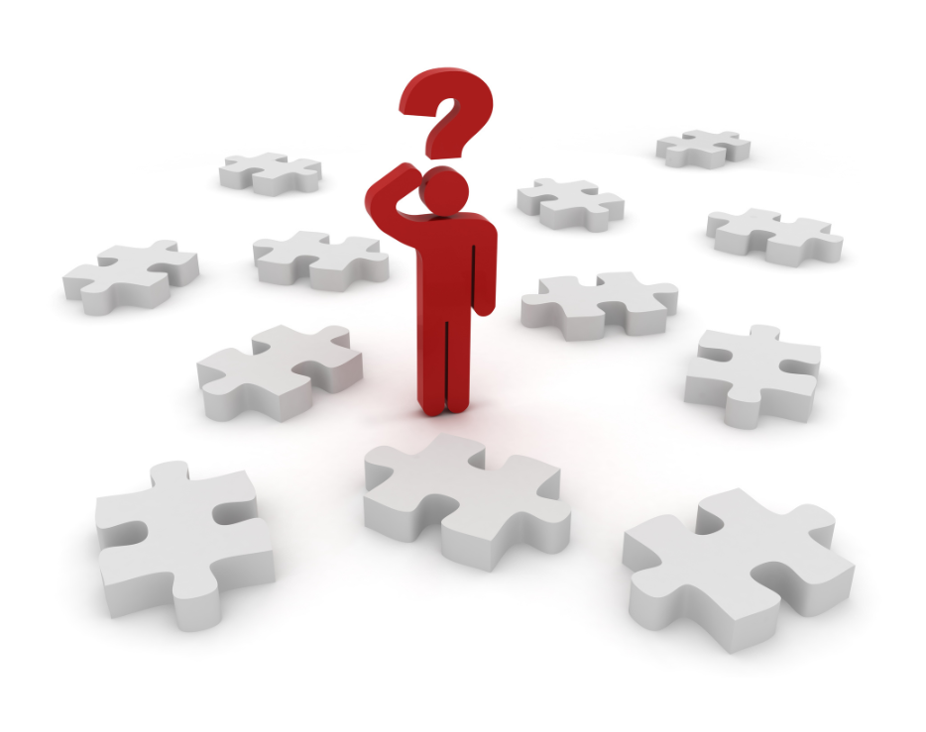
Problem Statement
With the rapid growth of Artificial Intelligence, usage patterns and digital behaviour is changing continuously. However, there is limited understanding of :
How AI adoption affects daily and monthly internet usage
Changes in digital trends across different user categories
User awareness regarding AI risks and costs
This project aims to address these challenges by analysing real-world data to identify trends, risks, and the overall impact of AI on users between 2023 and 2025.

Slide 5

System Architecture:
The system architecture of this project includes the following components:
Data Source
User survey data (AI usage, internet usage, cost, risk perception)
2. Data Processing
Data cleaning and transformation using Power BI
3. Data Analysis
Trend analysis, comparison, and categorization
4. Visualization Layer
Interactive dashboards, charts, and filters
5. Output
Insights on AI usage patterns and digital trends (2023–2025)

Slide 6

Proposed Solution
To analyse the impact of Artificial Intelligence on usage patterns, the following solution is proposed:
Collect and organize user data related to AI usage, internet usage, cost, and risk perception
Use Power BI to perform data cleaning, transformation, and visualization
Create interactive dashboards for year-wise comparison (2023–2025)
Identify trends, high-risk areas, and user behavior patterns

Slide 7
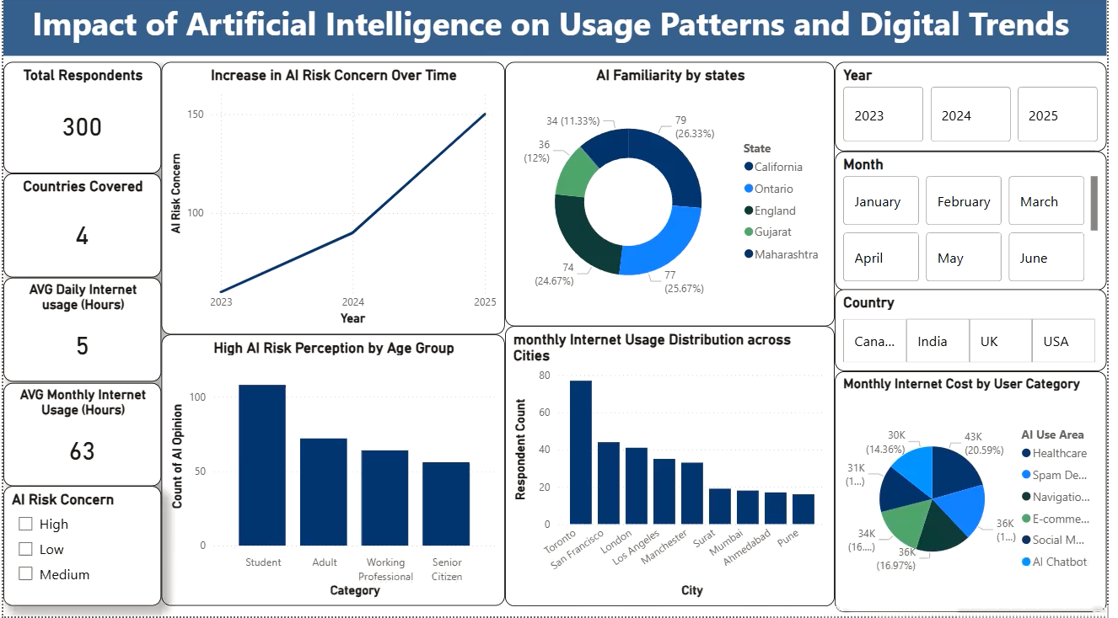
Video of Project Demo

Slide 8
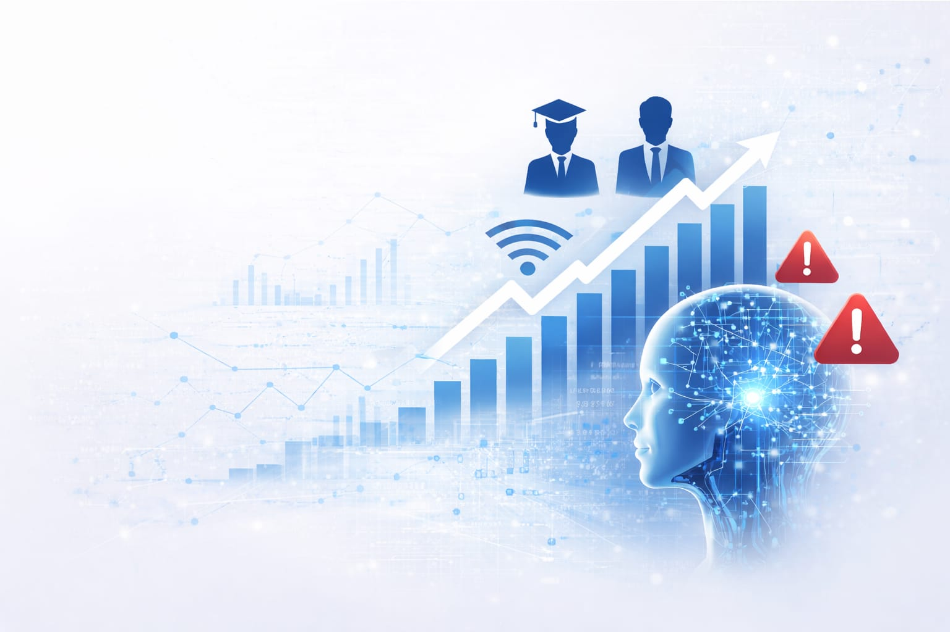
Key Findings
AI usage increased from 2023–2025
Students & professionals are main users
AI use increased internet consumption
Risk awareness about AI is rising

Slide 9

Conclusion
The project concludes that Artificial Intelligence has a significant impact on usage patterns and digital trends.
Key conclusions include:
AI usage has increased steadily from 2023 to 2025
Students and working professionals are the most active AI users
Higher AI usage is associated with increase in internet consumption and cost
Awareness of AI-related risks is growing among users
Overall, Artificial Intelligence is reshaping digital behaviour and influencing how users interact with technology..

Slide 10

Future Scope
The scope of this project can be expanded in the future by:
Including more respondents and additional countries
Integrating real-time data sources
Applying machine learning models for predictive analysis
Studying long-term social and economic impacts of AI
Enhancing dashboards with advanced AI-driven analytics
This will help in deeper understanding and better forecasting of AI-driven digital trends.

Slide 11
Thank You
Notes:
thank you very much for joining this PPT, keep learning.
11

